Slide 1

UHM in Michigan English
Variation and Change as a Lens on the Grammar
NWAV 54 – Montreal, Canada
Connor Bechler, Michigan State University
October 22nd, 2026

Slide 2
Overarching Question and Approach
Where and how is sociolinguistic variation implemented in the grammatical and speech processing systems?
Explores this with three variables in the MI Diaries Corpus
(Wagner & Sneller, 2020-)
  UHM (“uh” or “um”), AN (“a” or “an”), and THE (“ðə” or “ði”)
Intersecting variationist methods with theoretical analyses expands our understanding of both variation and cognition!

Slide 3
Some Definitions
UHM
(AN, THE)
“uh”
(“a”, “th[ə]”)
“um”
(“an”, “th[i]”)
Variable
Variants
Application Rate: marked / (unmarked + marked)

Slide 4
What’s known about UHM?
Correlates with pauses, interruptions, restarts → automatic
(Levelt, 1983; Clark & Foxtree, 2002; Corley & Stewart, 2008)
Shows cross-linguistic and dialectal variation → language specific
(Clark & Foxtree, 2002; Fruehwald, 2016; Wieling et al., 2016; Belz, 2023)
Shows cliticization and triggers flapping → in the phonology
(Clark & Foxtree, 2002; Pak, 2016)
But what is the earliest level of the morpho-phonology
by which UHM is phonologically specified?
Notes:
Late / nonlinguistic:
Correlates with pauses
Linguistic: language specific, arbitrary and learned
Cross-ling / dialect variation (citations)
Children show learning trajectory (citations)
Sociolinguistic variable
It's as early as phonological processes
Shows cliticization and triggers flapping

Slide 5
AN and THE as Grammatical Probes (Pak, 2016)
Morphological Spell-Out
AN allomorphy:
  √D[-def]+√apple → /æn.æpl̩/
THE allophony:
  Word-Internal Vowel Tensing:
    /ðɪ.æpl̩/ → /ði.æpl̩/
    /ðɪ.kæn/ → /ðɪ.kæn/
  Word-Internal Vowel Reduction:
    /ði.æpl̩/ → [ði.æpl̩]
    /ðɪ.kæn/ → [ðə.kæn]
Phonological Spell-Out
Notes:
So given that we know UHM shows variation in many dialects and is therefore learned, it can’t strictly be phonetic/articulatory -> but how can we cut closer?
following Marjorie Pak’s approach, we can use English article alternation as a probe into UHM’s position in the derivation

Slide 6
Locating UHM in Speaker’s Grammars
Three main tests:
If UHM varies in the corpus, must be acquired and grammatical, i.e., part of the derivation
If UHM triggers AN allomorphy, UHM must happen earlier in derivation
  “an um computer” vs. “a um computer”
If UHM triggers THE allophony, UHM must happen earlier in derivation*
  “th[i] um computer” vs. “th[ə] um computer”
*… unless it triggers THE like pauses do, in which case it could be phrasal (Pak, 2016), but feel free to ask why I don’t think this is the case during the Q&A

Slide 7
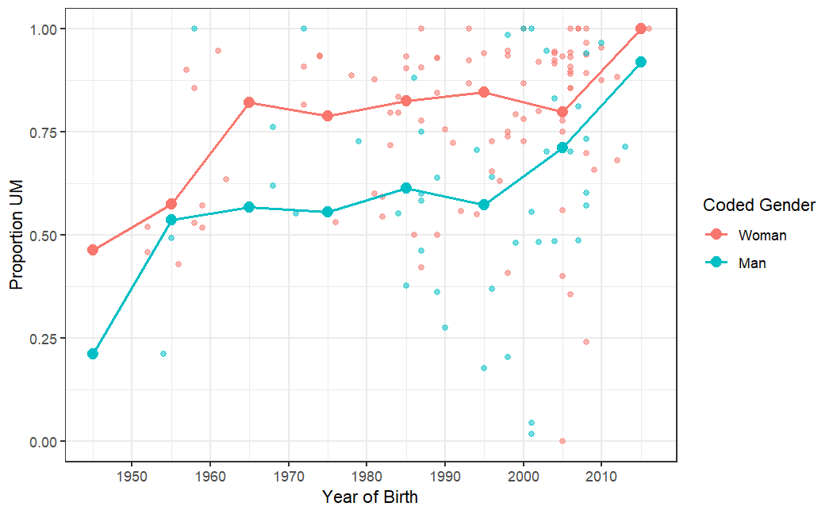
UHM is Undergoing Women-Led Apparent Time Change
Proportion UHM in the MI Diaries Corpus
(Bold lines shows rolling decade average)
Notes:
Classic apparent time change with women half a generation ahead of men
Mirrors Fruehwald’s finding in Philly
Now that we’ve shown UHM varies by gender and year of birth in Michigan and is arbitrary and learned, we can turn to the question of where it is spelled out
To answer this, I fit mixed effect logistic regression models to the UHM, THE, and AN data present in the MI Diaries

Slide 8
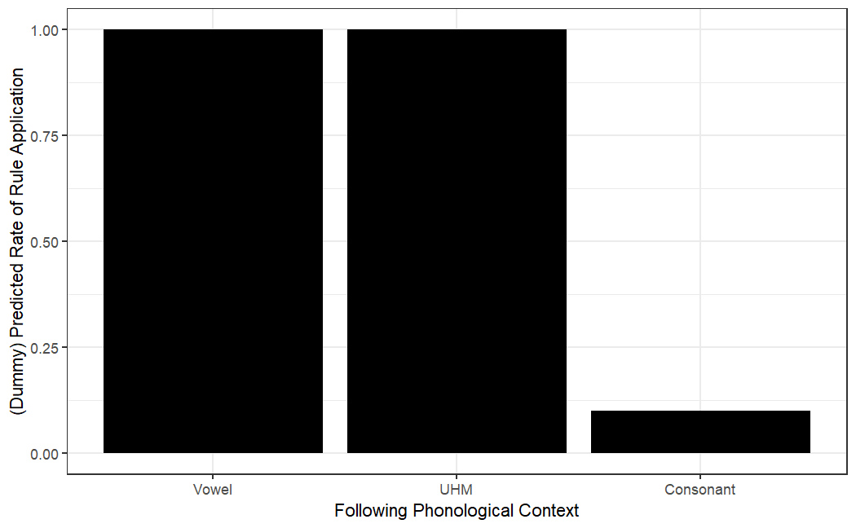
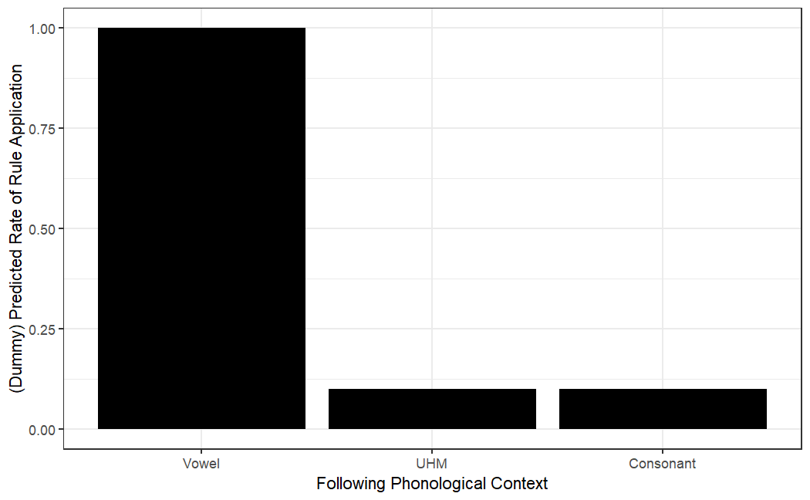
Does the grammar treat UHM like a vowel at a stage of the derivation?
If Yes
If No
Notes:
What you see here are dummy plots, what we want to know is does an UHM trigger allomorphy of a~an and allophony of thi~the. I’m plotting the predicted application rate (basically effect size) of a following vowel, a following consonant, a following pause, and a following uhm
If the Bar for UHM looks like the bar for vowels, it means phonological UHM is present at that stage of the derivation because the grammar is treating UHM as if it is a following vowel

Slide 9
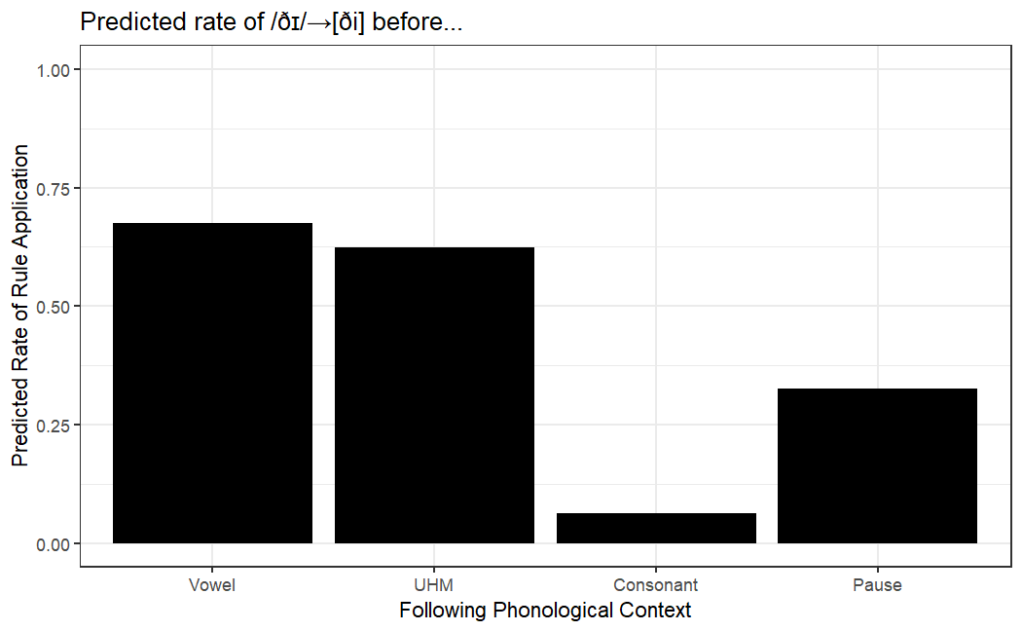
Following UHM predicts phonological [ði]…
[ði]
[ðə]

Slide 10
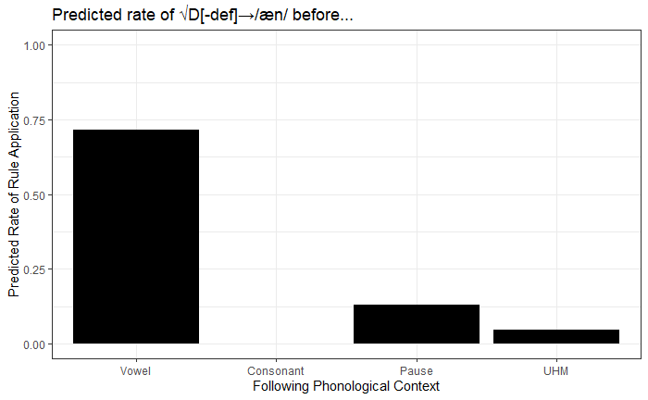
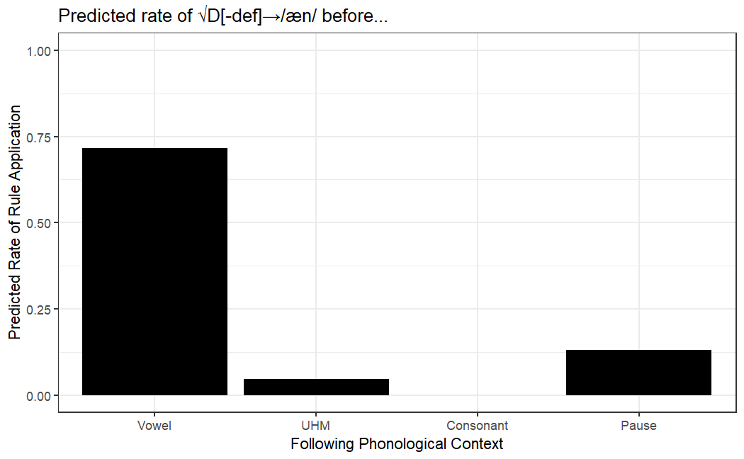
… but DOES NOT predict morphological an
an
a

Slide 11
Summary and Discussion

Slide 12
Key Findings
UHM is a sociolinguistic variable, arbitrary and learned
  Supports that change toward “um” observed by Fruehwald (2016) and Wieling et al. (2016) elsewhere is ongoing in Michigan
  “uh” and “um” are more like words than not (Clark & Foxtree, 2002)
UHM is specified during phonological spell-out
  Post morphology, but within word level phonology (Pak, 2016)
  Accounts for some of the strangeness observed by Levelt (1983)

Slide 13
References
Ash, S., & Myhill, J. (1986). Linguistic Correlates of Inter-Ethnic Contact. In D. Sankoff, Diversity and Diachrony (Vol. 53, pp. 33–44). John Benjamins Publishing Company.
Belz, M. (2023). Defining Filler Particles: A Phonetic Account of the Terminology, Form, and Grammatical Classification of “Filled Pauses.” Languages, 8(1), 57. https://doi.org/10.3390/languages8010057
Bolinger, D. L. (1946). Thoughts on “Yep” and ’Nope. American Speech, 21(2), 90–95. https://doi.org/10.2307/486479
Braginsky, M., Sanchez, A., and Yurovsky, D. (2022). childesr: Accessing the ’CHILDES’ Database.
Campbell-Kibler, K. (2016). Towards a Cognitively Realistic Model of Meaningful Sociolinguistic Variation. In A. M. Babel (Ed.), Awareness and Control in Sociolinguistic Research (pp. 123–151). Cambridge University Press. https://doi.org/10.1017/CBO9781139680448.008
Clark, H. H., & Foxtree, J. E. (2002). Using uh and um in spontaneous speaking. Cognition, 84(1), 73–111. https://doi.org/10.1016/S0010-0277(02)00017-3
Corley, M., & Stewart, O. W. (2008). Hesitation Disfluencies in Spontaneous Speech: The Meaning of um. Language and Linguistics Compass, 2(4), 589–602. https://doi.org/10.1111/j.1749-818X.2008.00068.x
Cox, F., Penney, J., & Palethorpe, S. (2023). Fifty years of change to prevocalic definite article allomorphy in Australian English. Journal of the International Phonetic Association, 53(3), 804–834. https://doi.org/10.1017/S002510032200007X
Fruehwald, J. (2016). Filled Pause Choice as a Sociolinguistic Variable. (6). https://repository.upenn.edu/handle/20.500.14332/45126
Gabrielatos, C., Torgersen, E. N., Hoffmann, S., & Fox, S. (2010). A Corpus-Based Sociolinguistic Study of Indefinite Article Forms in London English. Journal of English Linguistics, 38(4), 297–334. https://doi.org/10.1177/0075424209352729
Gadanidis, T. (2018). Um, about that, uh, variable [University of Toronto]. https://twpl.library.utoronto.ca/index.php/twpl/article/download/38599/29430
Gadanidis, T. (2025). Listener and reader perceptions of um and uh. https://doi.org/10.1075/prag.23060.gad
Gan, Q., & Travis, C. (2022, December 16). Ethnicity and social class in pre-vocalic the in Australian English. Proceedings of the Eighteenth Australasian International Conference on Speech Science and Technology. Australasian Speech Science and Technology Association.
Hudson Kam, C. L., & Edwards, N. A. (2008). The use of uh and um by 3- and 4-year-old native English-speaking children: Not quite right but not completely wrong. First Language, 28(3), 313–327. https://doi.org/10.1177/0142723708091149
Keating, P. A., Byrd, D., Flemming, E., & Todaka, Y. (1994). Phonetic analyses of word and segment variation using the TIMIT corpus of American english. Speech Communication, 14(2), 131–142. https://doi.org/10.1016/0167-6393(94)90004-3
Kidd, C., White, K. S., & Aslin, R. N. (2011). Toddlers use speech disfluencies to predict speakers’ referential intentions. Developmental Science, 14(4), 925–934. https://doi.org/10.1111/j.1467-7687.2011.01049.x
Labov, W., Sankoff, G., and Yang, C. (2025). On the learnability of linguistic variation.
Levelt, W. (1983). Monitoring and self-repair in speech. Cognition, 14(1), 41–104. https://doi.org/10.1016/0010-0277(83)90026-4
Levelt, W. J. (1992). Accessing words in speech production: Stages, processes and representations. Cognition, 42(1-3):1–22.
Levelt, W. J. M. (2000). Producing spoken language: A blueprint of the speaker. In C. M. Brown & P. Hagoort (Eds.), The Neurocognition of Language (pp. 82–122). Oxford University Press. https://doi.org/10.1093/acprof:oso/9780198507932.003.0004
MacWhinney, B. (2000). The CHILDES project: Tools for analyzing talk. Lawrence Erlbaum Associates, Manwah, NJ, third edition edition.
MacWhinney, B., & Osser, H. (1977). Verbal Planning Functions in Children’s Speech. Child Development, 48(3), 978–985. https://doi.org/10.2307/1128349
McAuliffe, M., Socolof, M., Mihuc, S., Wagner, M., and Sonderegger, M. (2017). Montreal forced aligner: Trainable text-speech alignment using kaldi. In Interspeech, volume 2017, pages 498–502.
Newell, H. and Sailor, C. (2023). Minimalism and the syntax-phonology interface.
Pak, M. (2016). How allomorphic is English article allomorphy? Glossa: A Journal of General Linguistics, 1(1). https://doi.org/10.5334/gjgl.62
Pak, M. (2017). The acquisition of English article alternations: Variation, competition and the default.
Paschen, L. (2025). The ubiquity of word-internal pauses. Linguistic Typology. https://doi.org/10.1515/lingty-2024-0093
Peck, N., & Becker, L. (2024). Syntactic pausing? Re-examining the associations. Linguistics Vanguard, 10(1), 223–237. https://doi.org/10.1515/lingvan-2022-0156
Preston, D. R. (2004). Three kinds of sociolinguistics: A psycholinguistic perspective. Sociolinguistic Variation: Critical Reflections, 140–158.
Rose, R. (2015). Um and Uh as Differential Delay Markers: The Role of Contextual Factors. Papers Presented at Disfluency in Spontaneous Speech, 73–77.
Stephens, H. (2019). Yep, indeed: The certainty of polarity particles yep and nope. Annual Conference of the Canadian Linguistics Association. https://cla-acl.ca/pdfs/resumes-2019-abstracts/Stephens.pdf
Tottie, G. (2016). Planning what to say: Uh and um among the pragmatic markers. In G. Kaltenböck, E. Keizer, & A. Lohmann (Eds.), Outside the Clause: Form and function of extra-clausal constituents (pp. 97–122). John Benjamins Publishing Company. https://www.degruyterbrill.com/document/doi/10.1075/slcs.178.04tot/html
Wesley, K., & Park, C. E. (2026, April 17). Social Perceptions of Uh and Um [Poster]. University Undergraduate Research and Arts Forum.
Wieling, M., Grieve, J., Bouma, G., Fruehwald, J., Coleman, J., & Liberman, M. (2016). Variation and Change in the Use of Hesitation Markers in Germanic Languages. Language Dynamics and Change, 6(2), 199–234. https://doi.org/10.1163/22105832-00602001

Slide 14
Bonus Slides

Slide 15
Y Model of the Grammar (Newell & Sailor, 2025)
Syntax
PF
LF
I
II
Notes:
I assume a classical Y model of the grammar. The implications of this view that matter for the present work are that the grammar is modular and feed-forward. Each module feeds into the next but cannot go the other direction.

Slide 16
Levelt’s (2000) Model of Speech Production
Rhetorical/Syntactic/
Semantic System
Phonological/Phonetic System
Conceptual Preparation
Morpho-Phonological Encoding
Self Perception
Phonetic Encoding
Grammatical Encoding
Articulation
Notes:
Since UH and UM have classically been labeled as part of speech repair (rather than inherently part of the grammar), we also need to consider a model of speech production. Levelt's is the one I'm using.

Slide 17
Argument for Cliticization of “Uh” and “Um”
(Clark and Foxtree, 2002)
“When cliticized onto and, but, the, a, and that, for example, they form prosodic words with trochaic stress and adjusted syllable boundaries: “an.duh”, “bu.tum”, “thi.yum”, “ai.yuh”, and “tha.tuh”’
(p. 104)

Slide 18
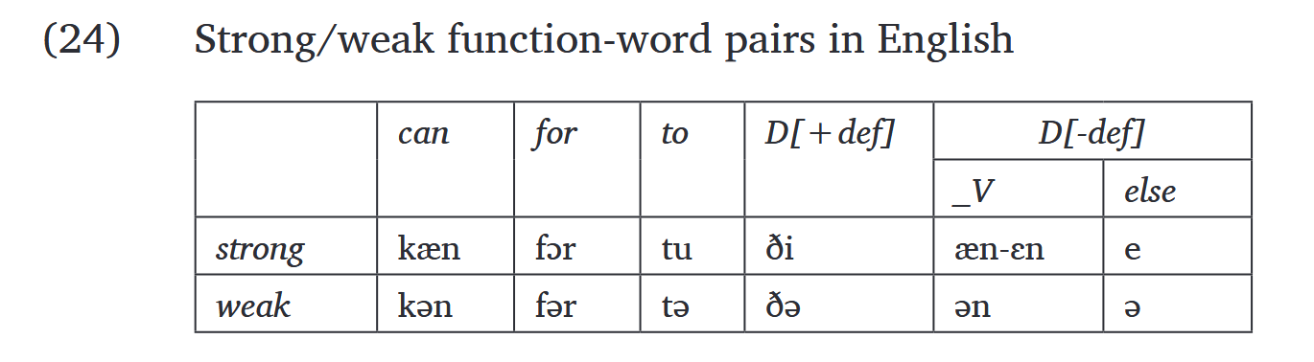
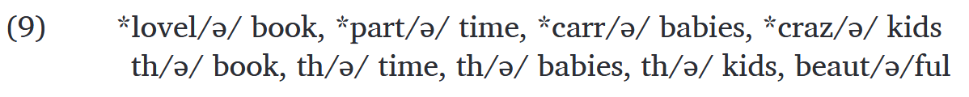
Argument for AN/THI Cliticization – Pt. I
(Pak, 2016)
Both AN and THI participate in the same pattern of vowel tensing and reduction found to occur with other function words
This process only happens word internally, so cliticization explains why it occurs for AN and THI

Slide 19
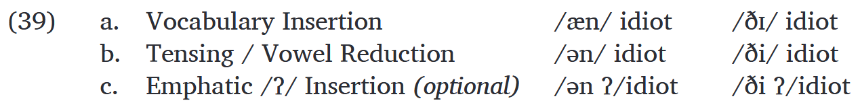
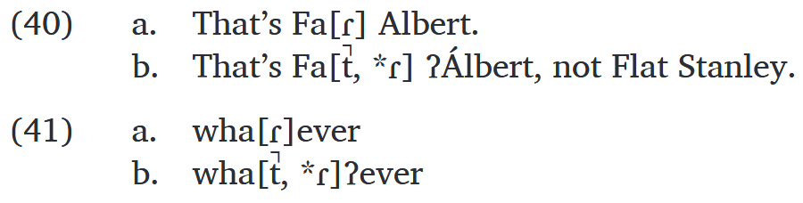
Argument for AN/THI Cliticization – Pt. II
(Pak, 2016)
Emphatic glottal stop insertion doesn’t prevent AN application OR THI application (p. 16)
Emphatic glottal insertion during resyllabification, before flapping

Slide 20
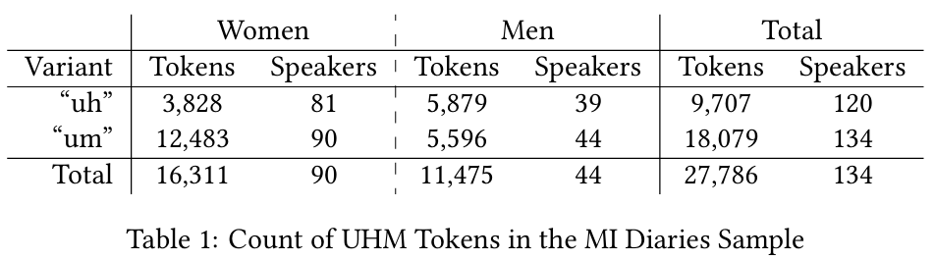
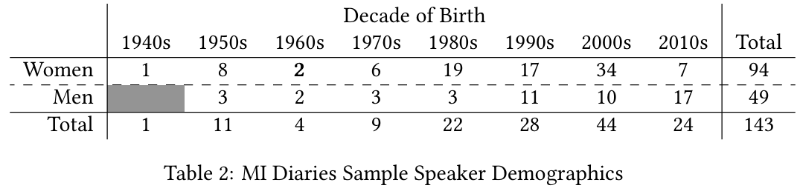
UHM Tokens in the MI Diaries (Sneller & Wagner, 2020-)
Notes:
A robust sample

Slide 21
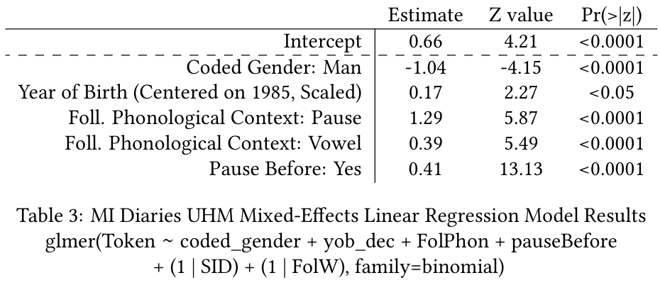
UHM is Conditioned by Pauses and the Following Word’s (Lack of) Onset
Notes:
To better understand [something / linguistic factors alongside social factors] I used a linear mixed effects model [with factors drawn from previous research]

Slide 22
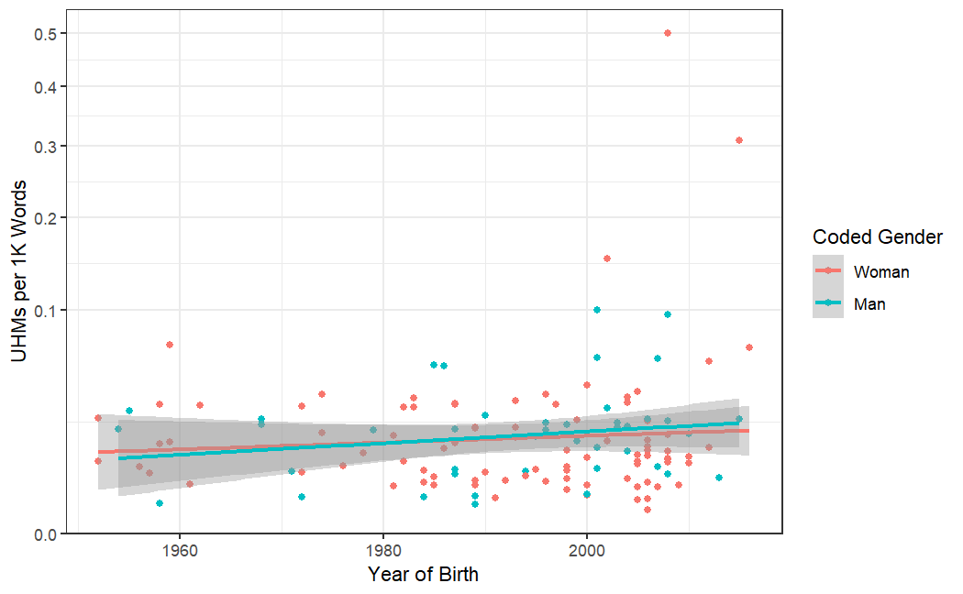
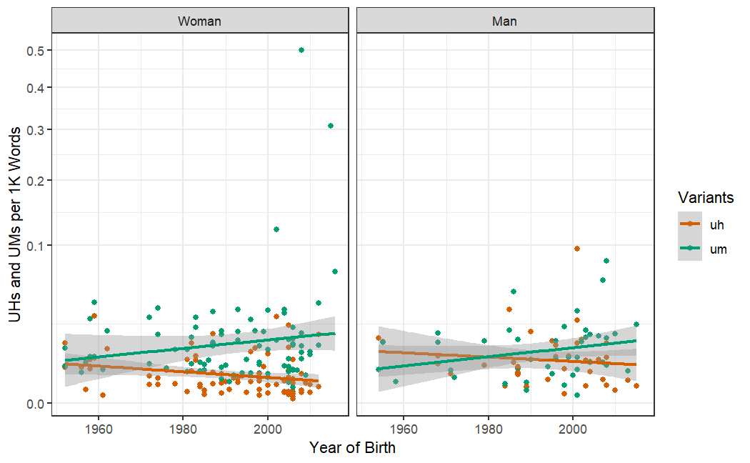
“Uh” and “Um” are Variants of the Same Variable
UHM’s frequency remains stable…
… as “uh” and “um” trade off
Rate of UHM per 1,000 Tokens
by Diarist and Year of Birth
Rate of “Uh” and “Um” per 1,000 Tokens
by Diarist and Year of Birth
Notes:
Before turning to its sociolinguistic behavior, I want to confirm that UH and UM are actually two variants of a single variable.
To to this, I plotted the rate of UH+UM per 1k words (figure X) - as you can see, it's straight – people are using pause fillers at the same rate across time.
Figure Y plots UH separately from UM, showing that there is a direct tradeoff: when people use UM more, they use UH less.
These facts tell us that we are likely dealing with a true sociolinguistic variable.

Slide 23
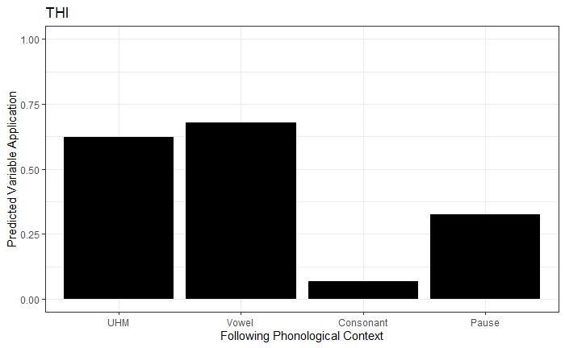
UHM triggers THI alternation differently from Following Pauses
[ði]
[ðə]

Slide 24
AN and THE Model Results
Formula: Token ~ FolPhon + pauseBefore + (1 | SID)
AN Models
THE Models
 | Estimate | Std. Error | z value | Pr(>|z|)
(Intercept) | 0.92352 | 0.07573 | 12.194 | <2e-16***
Consonant | -8.61505 | 0.29508 | -29.196 | <2e-16***
Pause After | -2.82553 | 0.22883 | -12.348 | <2e-16***
UHM | -3.94733 | 0.41869 | -9.428 | <2e-16***
Pause Before | -0.15110 | 0.14078 | -1.073 | 0.283
 | Estimate | Std. Error | z value | Pr(>|z|)
(Intercept) | 0.73972 | 0.09433 | 7.842 | 4.44e-15***
Consonant | -3.38591 | 0.05870 | -57.682 | <2e-16***
Pause After | -1.46957 | 0.21122 | -6.958 | 3.46e-12***
UHM | -0.23918 | 0.14103 | -1.696 | 0.0899
Pause Before | 0.34655 | 0.07063 | 4.907 | 9.27e-07***
FolPhon Reference Level: Vowel
FolPhon Reference Level: Vowel
 | Estimate | Std. Error | z value | Pr(>|z|)
(Intercept) | -3.0238 | 0.4226 | -7.155 | 8.39e-13***
Vowel | 3.9473 | 0.4193 | 9.414 | <2e-16***
Consonant | -4.6677 | 0.5080 | -9.188 | <2e-16***
Pause After | 1.1218 | 0.4742 | 2.366 | 0.018*
Pause Before | -0.1511 | 0.1408 | -1.073 | 0.283
 | Estimate | Std. Error | z value | Pr(>|z|)
(Intercept) | 0.50054 | 0.16022 | 3.124 | 0.00178**
Vowel | 0.23917 | 0.14131 | 1.693 | 0.09055
Consonant | -3.14673 | 0.14042 | -22.410 | <2e-16***
Pause After | -1.23041 | 0.24690 | -4.983 | 6.25e-07***
Pause Before | 0.34655 | 0.07063 | 4.907 | 9.27e-07***
FolPhon Reference Level: UHM
FolPhon Reference Level: UHM

Slide 25
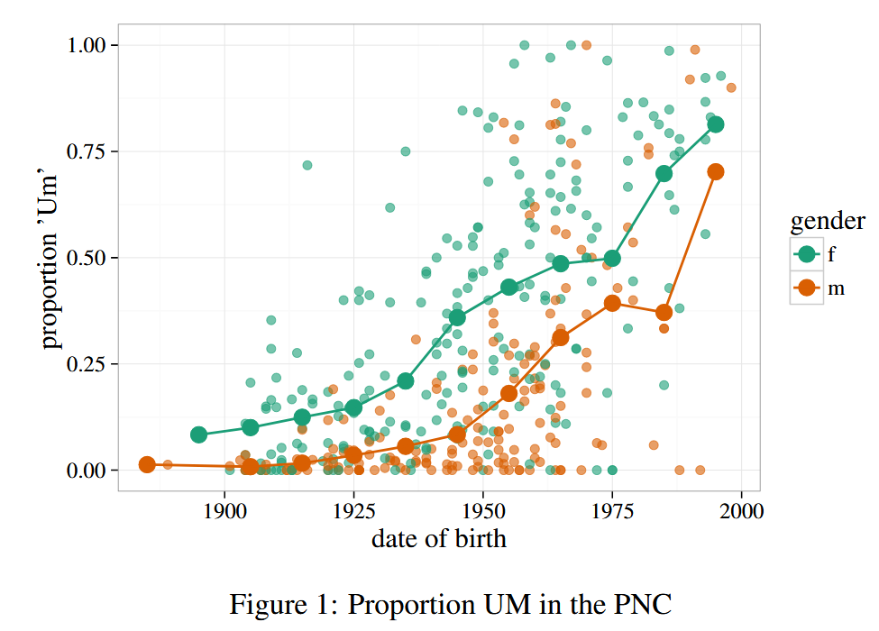
UHM in Philadelphia
(Fruehwald, 2016)

Slide 26
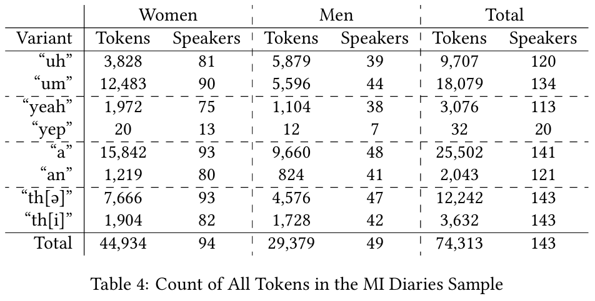
MI Diaries Tokens of YEP, AN, and THI

Slide 27
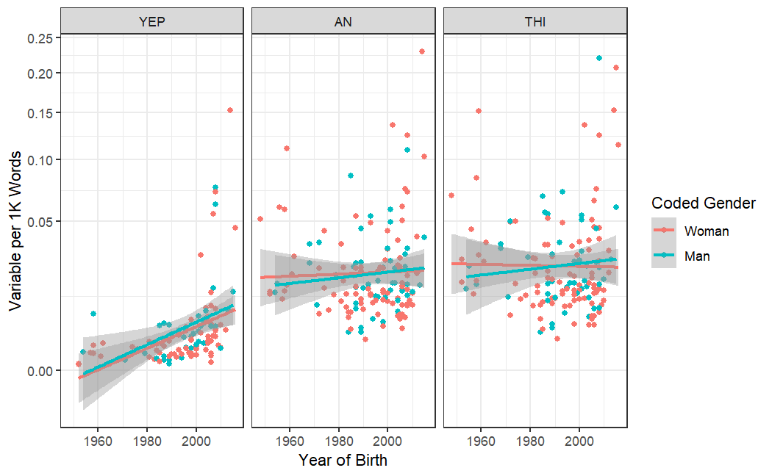
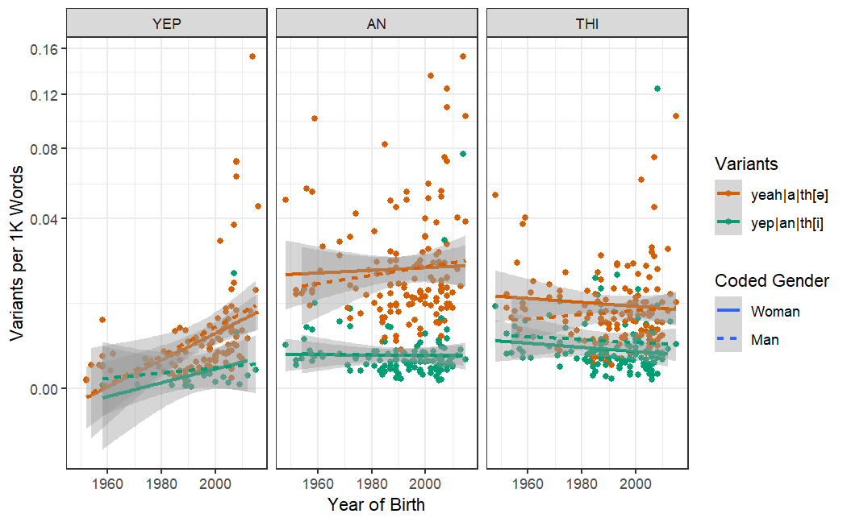
AN and THI are Sociolinguistic Variables
AN and THI are (relatively) stable…
AN and THI’s variants trade off
Rate of Comparison Variables per 1,000 Tokens
by Diarist and Year of Birth
Rates of Comparison Variants per 1,000 Tokens
by Diarist and Year of Birth
… while YEP increases.
… while YEP’s do not.
Notes:
Suzanne: Stronger acknowledgement of the fact that I haven’t well defined the envelope of variation for UH and UM (and certainly not for YEAH and YEP).
Also need to acknowledge that UH and UM could be doing different things, maybe utterance initially it’s doing functional work it’s not doing in the utterance
Karthik: H and ng in complementary distribution, but not the same phoneme! Need to put severe limitations on what defines contrast
Can you show a trade off in a controlled context?
CB: Interjections, so constraining them is difficult

Slide 28
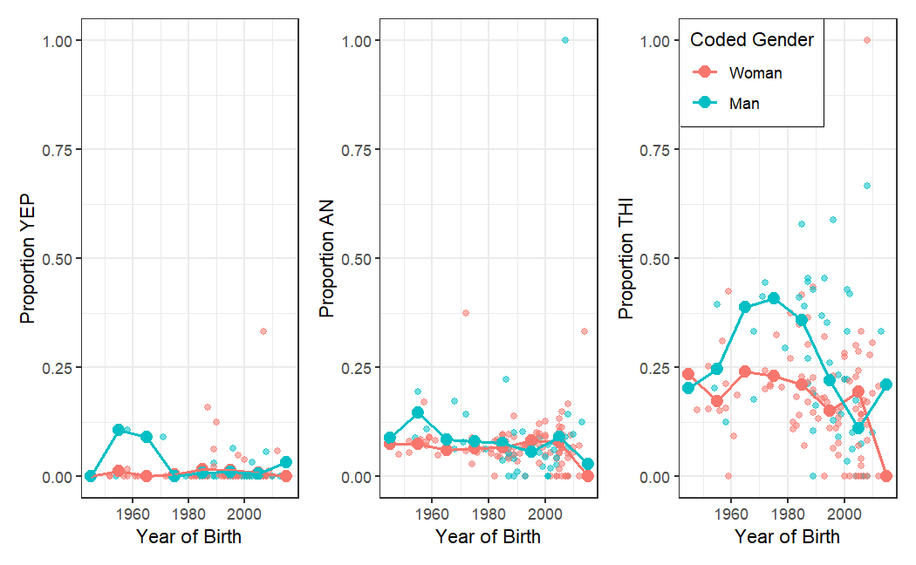
THI shows Women-Led Change in Apparent Time (while AN doesn’t)
Proportion Comparison Variables in the MI Diaries Corpus
(Bold lines shows rolling decade average)

Slide 29
How UHM is acquired
Examining child and parent use of UHM in CHILDES (MacWhinney, 2000)
Notes:
Cristina: Need to get rates of UH and UM variants in CHILDES to see if people are using them the same way as adults
Karthik: What kind of controls can you put in place to make the comparison between corpora more appropriate?

Slide 30
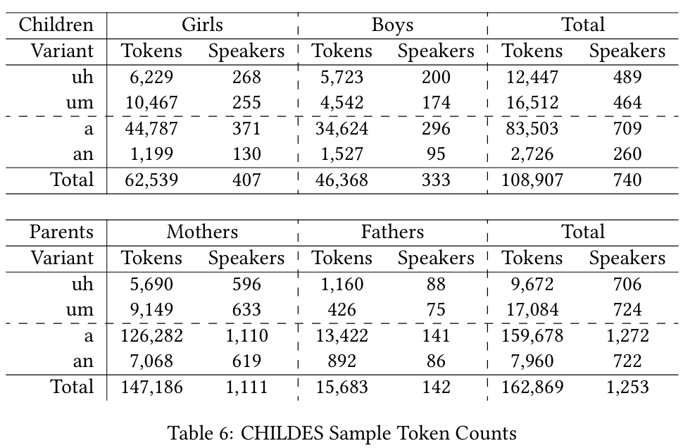
CHILDES Speakers and Tokens
Notes:
Tokens of child and child-directed parental speech collected from CHILDES North American English Subcorpora

Slide 31
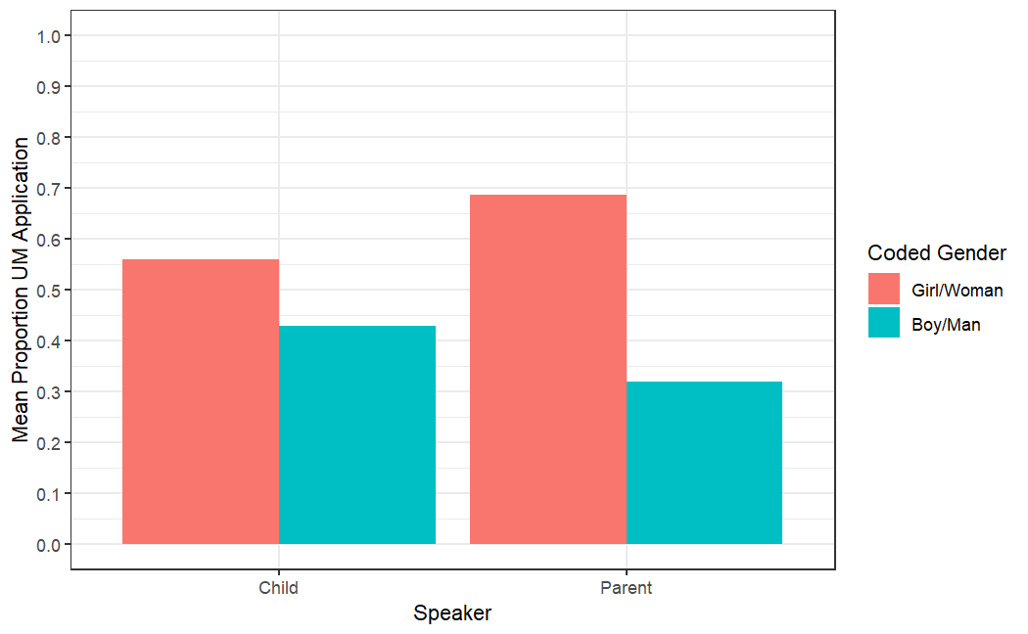
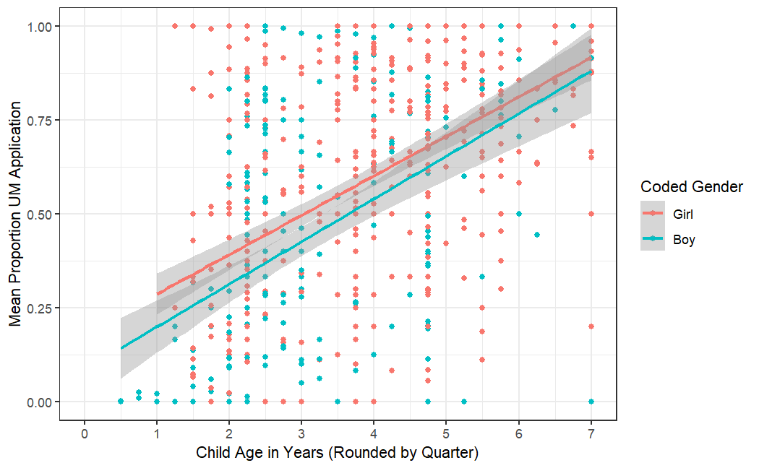
UHM Exhibits Gendered Use in CHILDES
Present for Children and Adults…
… and Present at an Early Age
Mean Proportion UHM by Speaker and Gender
in CHILDES
Proportion UHM of Children by Age in CHILDES
(Age in Quarter Years)
Notes:
First, we can see that both children and their parents show the gendered difference; (explain plot)
moreover it appears to be present at a young age (explain plot)

Slide 32
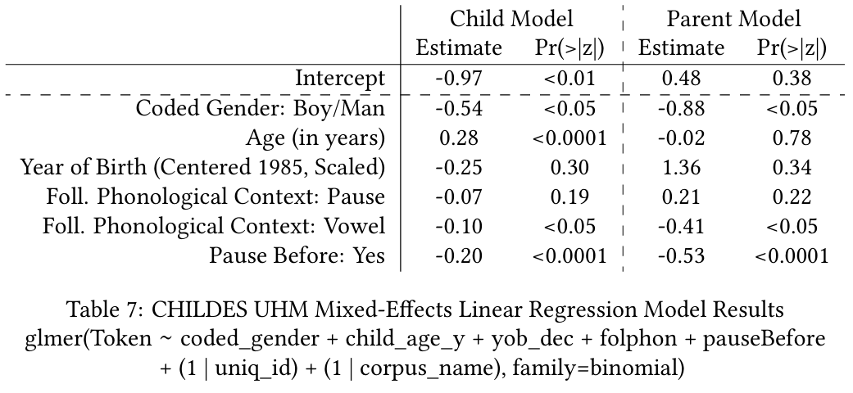
Children Acquire UHM Like Their Parents
(…and both are unlike the MI Diaries speakers)
Notes:
Suzanne: t/d/ deletion patterns differently Philly vs New York English(?) -> Greg Guy

Slide 33
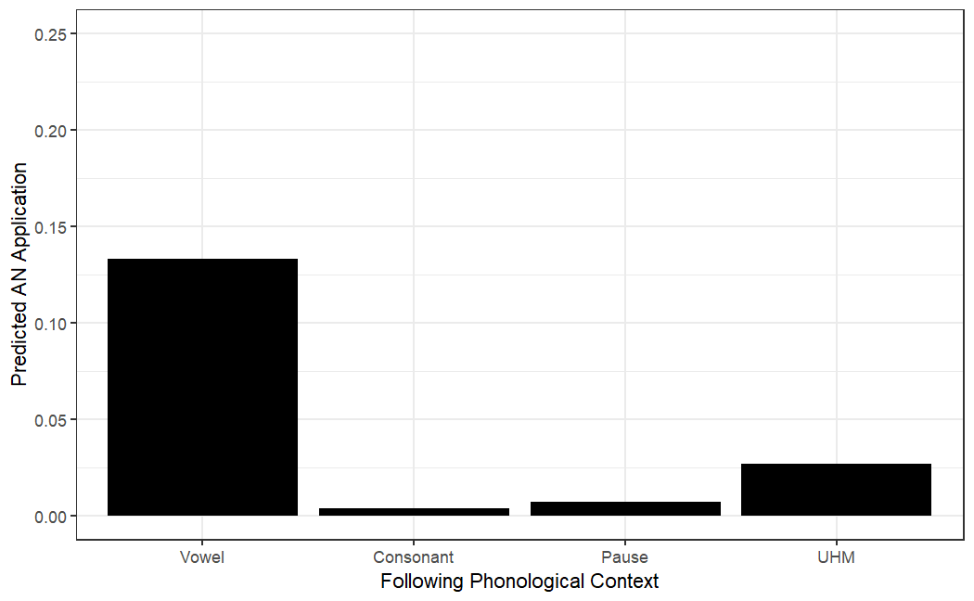
Children’s AN is not triggered by UHM
**
**
**
Predicted Variable Application of AN by Following Context

